Slide 1
TutorMe AI
AI-Powered Personalized Learning Buddy
Presented by-
Shruti Agarwal
Farhan Ahmad
Shubham Pratap
Pragya Singh
1

Slide 2
1. Problem & Proposed Solution
• Traditional learning resources often provide the same explanation to every learner.
• Students may struggle to understand difficult concepts without immediate, personalized guidance.
• TutorMe AI acts as a 24/7 learning buddy for a topic of the learner’s choice.
• It uses Gemini to explain concepts in simple, beginner-friendly language.
• The system combines explanation, examples, assessment, feedback, and chat in one interface.
2

Slide 3
2. Main Features
Explain Concept
Simple explanation, one analogy, and a check-in question.
Real-Life Example
Step-by-step everyday example connected to the topic.
Generate Quiz
5 MCQs, easy-to-hard ordering, scoring and explanations.
Ask Anything
Beginner-friendly answers to student questions.
Chat with TutorMe
Ongoing conversation with chat history/memory.
3

Slide 4
3. System Architecture & Workflow
Student → Selects activity and enters a topic/question
Streamlit UI → Receives input and controls the selected activity
Prompt + Persona → Builds a beginner-friendly prompt using the TutorMe persona
Gemini 2.5 Flash → Generates explanation, example, quiz, answer or chat response
Processing → JSON quiz parsing / scoring / session handling
Student Feedback → Displays result, explanations and conversational response
4

Slide 5
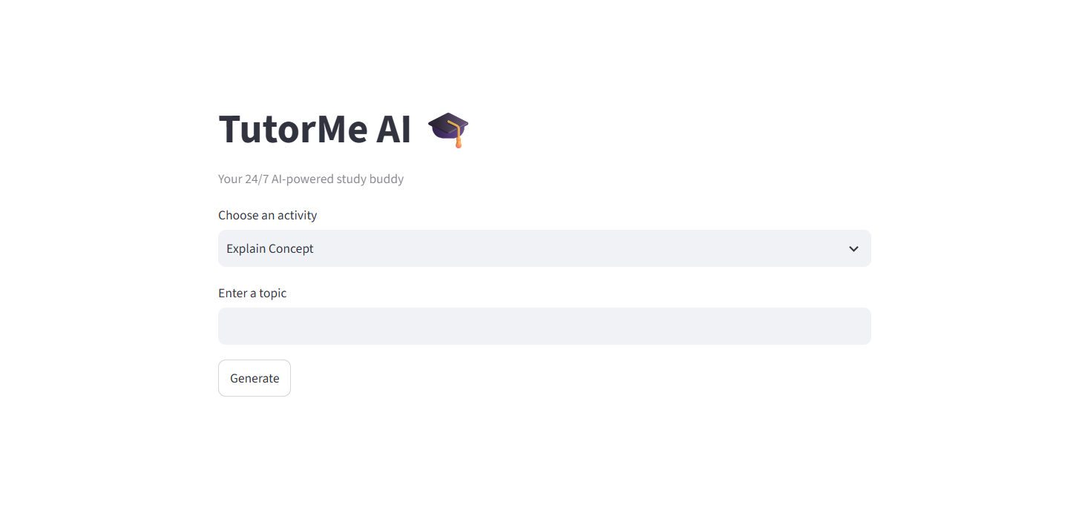
Dashboard

Slide 6
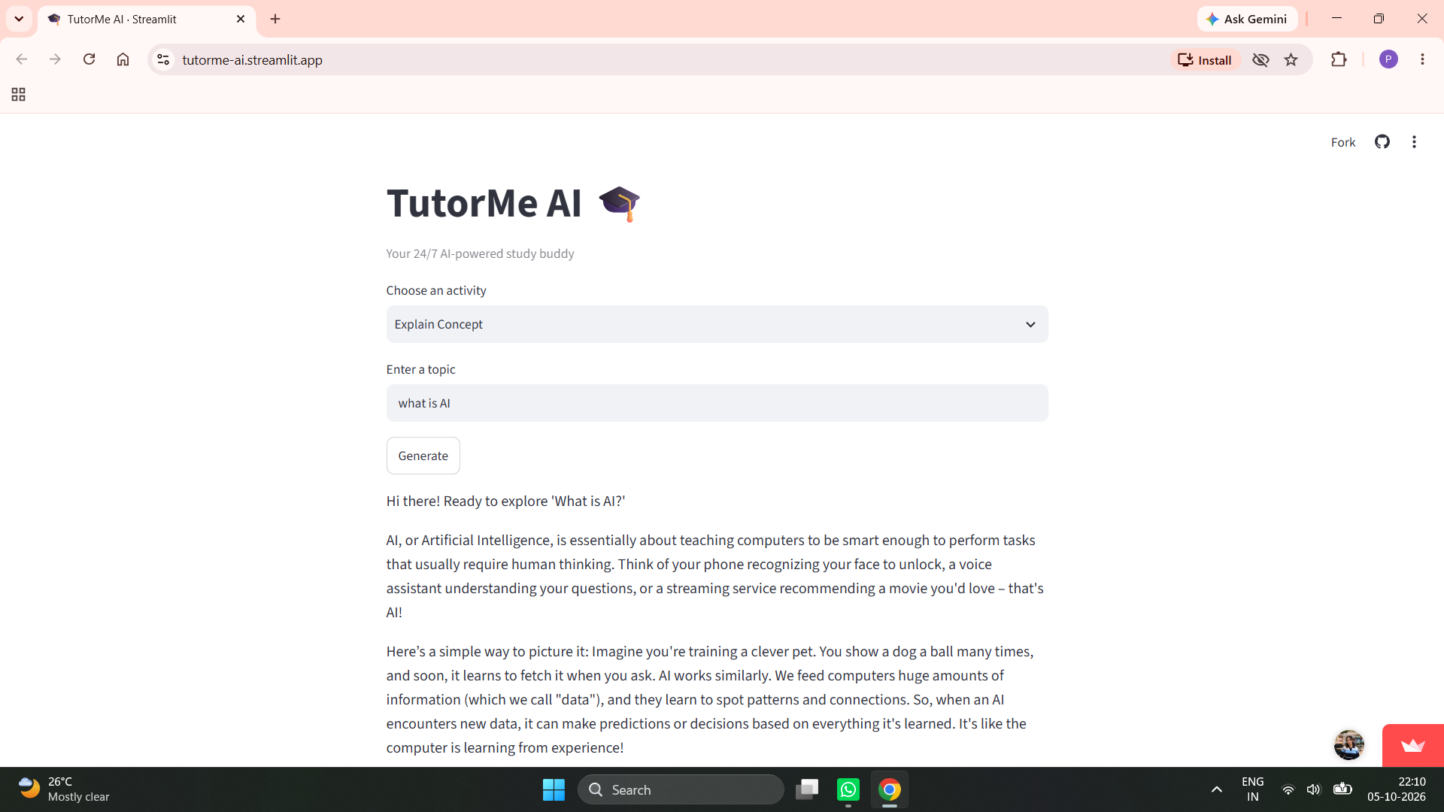
Demonstration

Slide 7
4. Technology Stack & Implementation
• Frontend / UI: Streamlit — provides the interactive web interface and activity selector.
• AI Model: Google Gemini 2.5 Flash via the Google GenAI SDK.
• Language: Python — application logic, prompting, quiz handling and session management.
• State & Chat Memory: Streamlit session_state stores quiz data, answers, history and chat session.
• Reliability: safe_generate() handles empty/malformed responses and retries failed Gemini calls once.
• Quiz Engine: Gemini returns structured JSON; the app renders MCQs, auto-grades them and shows explanations.
5

Slide 8
5. Working Example & Conclusion
• Input: Student chooses “Explain Concept” and enters “Machine Learning”.
• AI Response: TutorMe explains the concept using simple language and one relatable analogy.
• Next Step: Student can ask a follow-up question through the conversational tutor.
• Assessment: Selecting “Generate Quiz” creates five MCQs from easy to hard and calculates the score.
• Feedback: Each answer includes the correct answer and a short explanation.
Conclusion
TutorMe AI turns a general-purpose LLM into a focused, interactive study companion.
6

